Slide 1
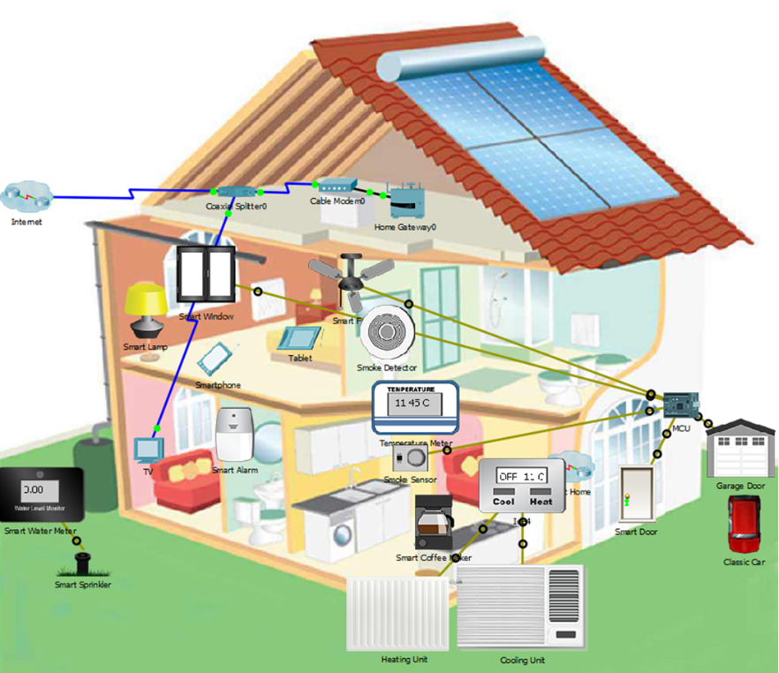
Threat Modelling to Assess Risk in an IoT System
Nathan, Shea, Alex, and Anthony

Slide 2

Part 1 Data Flow Diagram

Slide 3
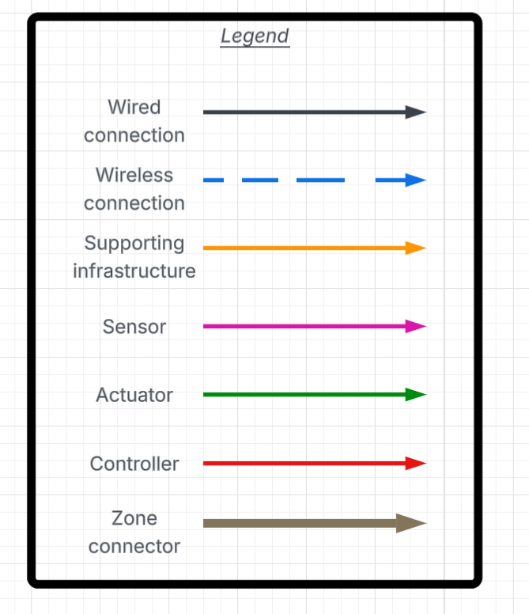
Legend for the Zones

Slide 4
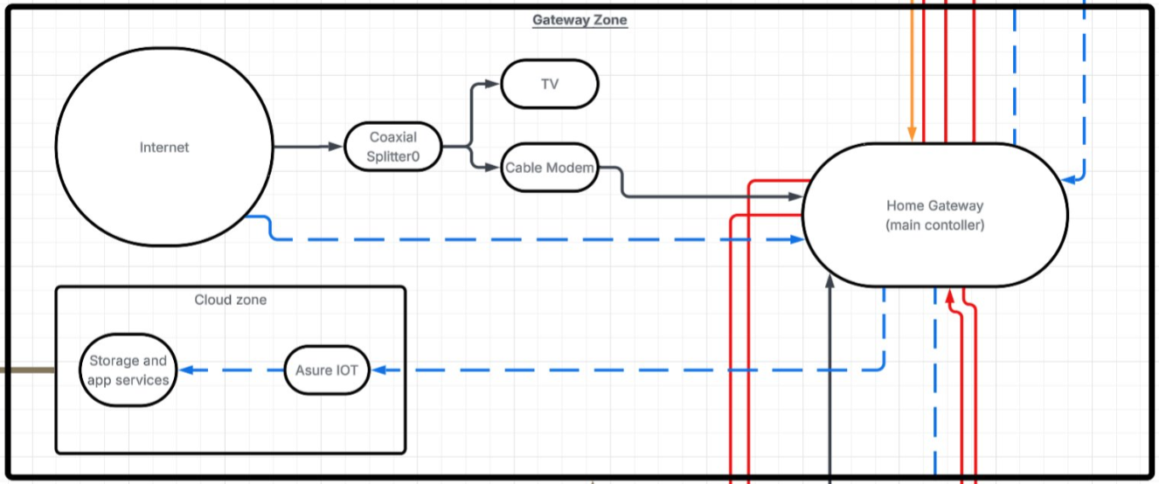
Gateway Zone

Slide 5
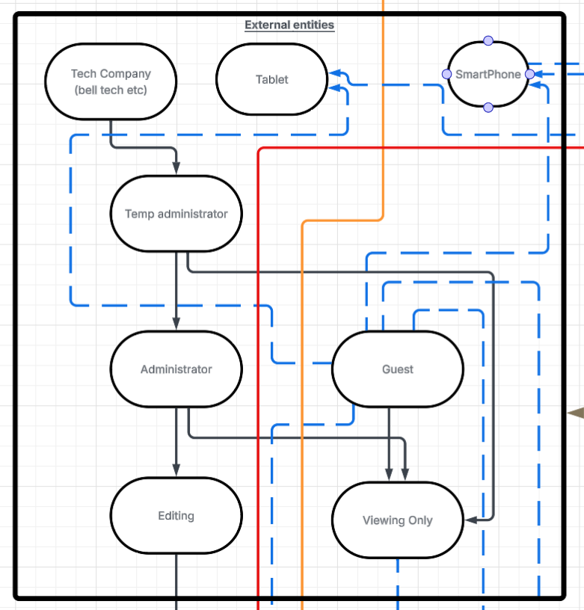
External entities Zone

Slide 6
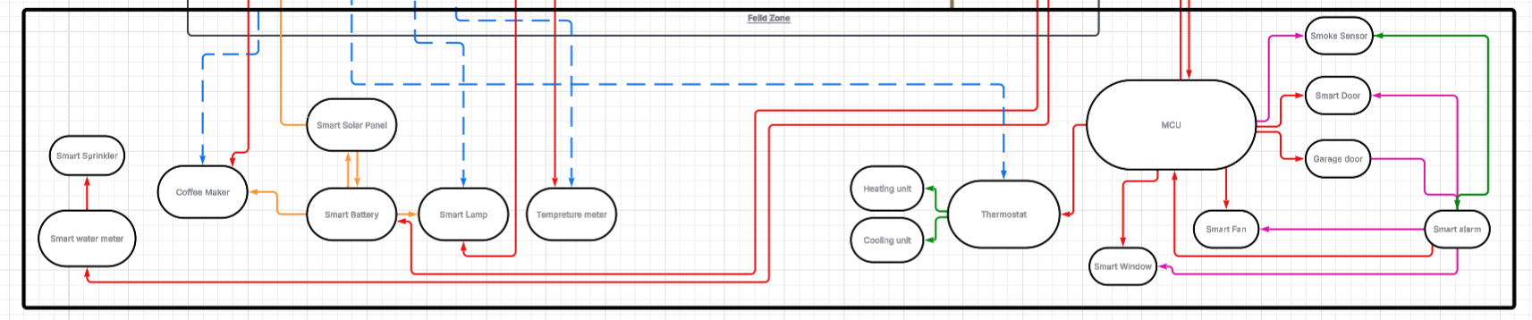
Field Zone

Slide 7
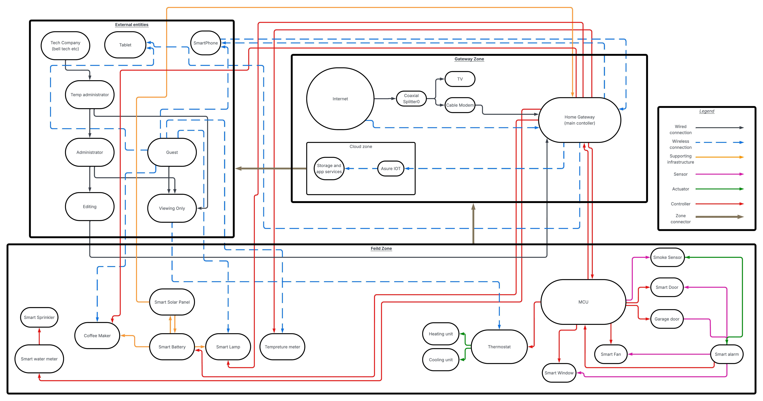
All the zones

Slide 8
Interactive Zones
https://lucid.app/lucidchart/e7a7a668-a8bb-4a19-bf6a-86c79e1772df/edit?viewport_loc=-3334%2C-1277%2C5848%2C3019%2C0_0&invitationId=inv_2228216d-75b7-4698-aba6-afe93a8a9f0e
This is just a link to the same zone on the other slide just interactive

Slide 9

Part 2 Risk assessment using DREAD

Slide 10
Attack Surface and Threat | D | R | E | A | D | Total
Solar panel | 2 | 3 | 1 | 3 | 3 | 12
Smart window | 3 | 3 | 2 | 3 | 3 | 14
Smart water meter | 2 | 3 | 2 | 3 | 3 | 13
Smart alarm | 3 | 3 | 3 | 3 | 3 | 15
Smart phone | 3 | 3 | 2 | 3 | 3 | 14

Slide 11
Attack Surface and Threat | D | R | E | A | D | Total
Smart fan | 1 | 3 | 1 | 3 | 3 | 11
Smart door | 3 | 3 | 2 | 3 | 3 | 14
Smart coffee maker | 1 | 3 | 1 | 3 | 3 | 11
Garage door | 3 | 3 | 2 | 3 | 3 | 14
Smart battery | 2 | 3 | 1 | 3 | 3 | 12
Smart sprinkler | 1 | 3 | 1 | 3 | 3 | 11

Slide 12
Attack Surface and Threat | Total | Likelihood
Smart alarm | 15 | 3
Smart phone | 14 | 3
Garage door | 14 | 2
Smart window | 14 | 2
Smart door | 14 | 3
Smart water meter | 13 | 2
Smart battery | 12 | 3

Slide 13

Part 3 Risk Response for the Rated Risks

Slide 14
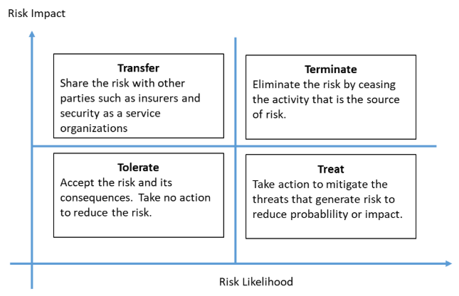

Slide 15
Smart Alarm
Terminate
Implement a physical secure pin code.
Remove the ability to disarm remotely. ​
Actively log all sensor / alarm communications.
Denial of service via jamming
Treat
Smart Door
Treat
Implement additional layers of security controls including audit logs.
MFA.
Secure door using rolling code encryption for key cards.
A physical key.
Direct risk of physical breach
Smart Window
Treat
Implement sensor redundancies and mechanical overrides. Ensure function of physical locking mechanisms.
Direct risk of breach via sensor bypass

Slide 16
Smartphone
Treat
Implement MFA and network restrictions.
Implement VPN usage, biometric authentication, verify user group permissions.
Risk of credential theft.
Garage Door
Treat​
​
Secure door with rolling code encryption.
Secure door using rolling code encryption and mechanical backups.
Actively log all sensor communications.
Risk of breach via stolen credentials
or exploit
Smart Water Meter
Tolerate
Manually verify an acceptable risk level and adjust
Risk of data manipulation leading to poor data
Smart Battery
Treat​
​
Maintain consistent firmware updates. Keep logs of activity. Utilize VLAN segmentation.
Risk of UPS firmware tampering

Slide 17

Part 4 Considering Risk Mitigation Strategies

Slide 18
Smartphone
Threat
Risk Response
Mitigation Strategy
Having the phone use a VPN and on a secure network, even as much as limited IPS of known unsecure websites apps
Treat
Smart Battery
Have the smart battery on a monitored system checking for power flow, Aswell as having it on a secured and separate VLAN
Treat
Smart Door
If the smart door is hooked up to a voice system have a internal radius of voice commands, also having it on its on VLAN disconnected from other devices.
Treat & terminate

