Slide 1

Network Segmentation and Containment
Nathan Boudreau

Slide 2
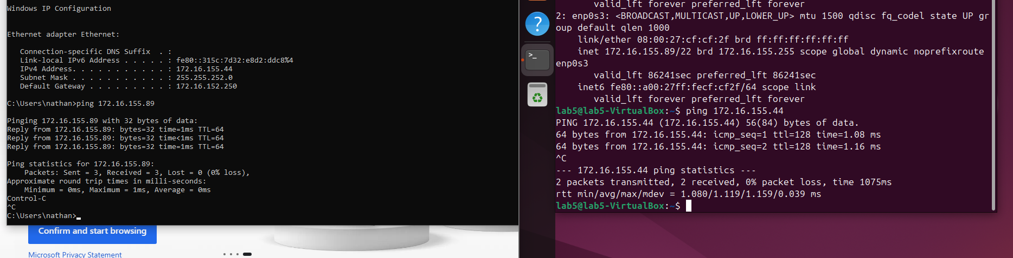
Both can communicate

Slide 3
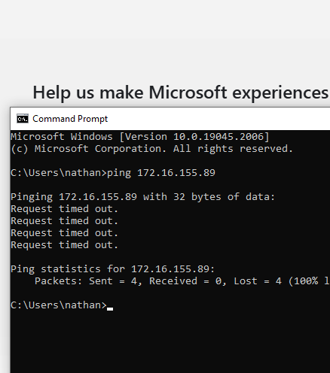
Part 2
After enabling the firewall, you can no longer ping the pc because it blocks all forms of communication to the pc
This simulates the firewall in-between systems by blocking pings from another system.

Slide 4

Part 3
Added rule to allow the windows VM to ssh on any port 22

Slide 5
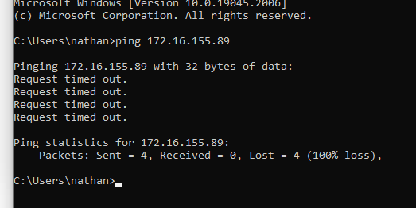
Step 2
Ping from windows pc still wont work because of previous UFW rules in place on the firewall

Slide 6
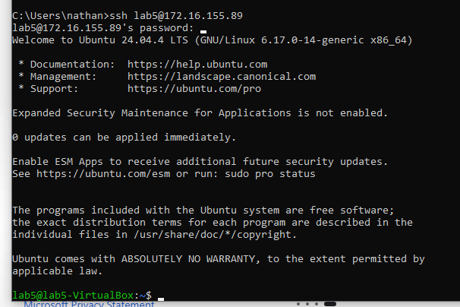
Step 2 - Connect via ssh
Ssh still works because you allowed it to connect

Slide 7
Questions
1. Why should only required services be allowed between network segments?
  Because it reduces the attack surface and allows tech support/IT to fix things
2. How does this reduce risk during an incident?
  You block the things you don’t want and allow the things you do. I.E allows tech via ssh, blocks pings for Nmap or whatnot

Slide 8

Part 4 step 1
Deny all

Slide 9
Step 2
Test connectivity from windows
It will no longer connect after a reload of the firewall

Slide 10
Questions
How does this simulate a quarantine VLAN?
  By quickly separating the VLAN so tech can work on issues
Why should infected systems remain powered on during an incident?
  Because a lot can be stored in RAM and when turned off it will get deleted
How does containment reduce ransomware spread?
  By blocking everything in and out of the pc allows for containment, nothing gets in or out
Why is segmentation critical for incident response?
  So, you can understand how the incident happened and stop it on other pcs of needed

